Slide 1

Smart Parking
Project supervisor
Dr.Muhamed Attar
Group members :
1- Bassam Alghamdi 2141362
2- Mohammed Alharthi 2141944
3- Mohammed yar 2142893

Slide 2
General project idea
We have noticed the problems students and staff face in looking for parking at universities, and among the problems we have observed are:
1- The difficulty to find the information about the university parking
2- Difficulty finding parking
3- The difficulties that all staff and students face in finding parking spaces

Slide 3
Use Case Diagram:
+--------------------+
| Smart Parking |
+--------------------+
|
|
+-----------+
| User |
+-----------+
|
+-------------------------------------+
| Find Parking Space |
+-------------------------------------+
| |
+----------------------------------+ +----------------------------------+
| View Parking Information | | Reserve Parking Space |
+----------------------------------+ +----------------------------------+
| |
+------------------------+ +---------------------------+
| Check Availability | | Confirm Reservation |
+------------------------+ +---------------------------+

Slide 4
Business Objective
1- Facilitate students' access to parking lots and save time and effort
2- Continuously updated information about car parks
3- Facilitate students to make the right decisions to gain time

Slide 5
Functional Requirements:
Provide a user-friendly interface for users to access parking information.
Display real-time parking availability for different parking areas.
Allow users to search for available parking spaces based on location, time, and other preferences.
Enable users to reserve parking spaces in advance.
Send notifications to users regarding parking availability and reservation confirmation.
Provide a secure payment system for parking fees.
Generate reports on parking usage and revenue.

Slide 6
Non-Functional Requirements:
Performance: Provide fast response times and handle concurrent user requests efficiently.
Scalability: Accommodate growing user and data needs.
Reliability: Ensure accurate and up-to-date parking information with minimal errors or downtime.
Security: Implement strong measures to protect user data and payment information.
Usability: Offer an intuitive and visually appealing interface for users of varying technical abilities.
Accessibility: Comply with accessibility standards for users with disabilities.
Compatibility: Support a wide range of devices and platforms for optimal user experience.
Maintainability: Design for easy updates, bug fixes, and future enhancements.
Integration: Allow integration with other systems or services.
Compliance: Adhere to relevant laws, regulations, and industry standards.

Slide 7
Budget Projection:
Project management:
Assuming 300 hours of project management work at 25 riyal per hour: 300 hours * 25 riyal = 7,500 riyal
Application workers:
Assuming 400 hours of work at 20 riyal per hour: 400 hours * 20 riyal = 8,000 riyal
Designers:
Assuming 200 hours of design work at 25 riyal per hour: 200 hours * 25 riyal = 5,000 riyal
Equipment:
Equipment cost: 15,000 riyal
Total Project Cost Estimate: 7,500 riyal + 8,000 riyal + 5,000 riyal + 15,000 riyal = 35,500 riyal

Slide 8
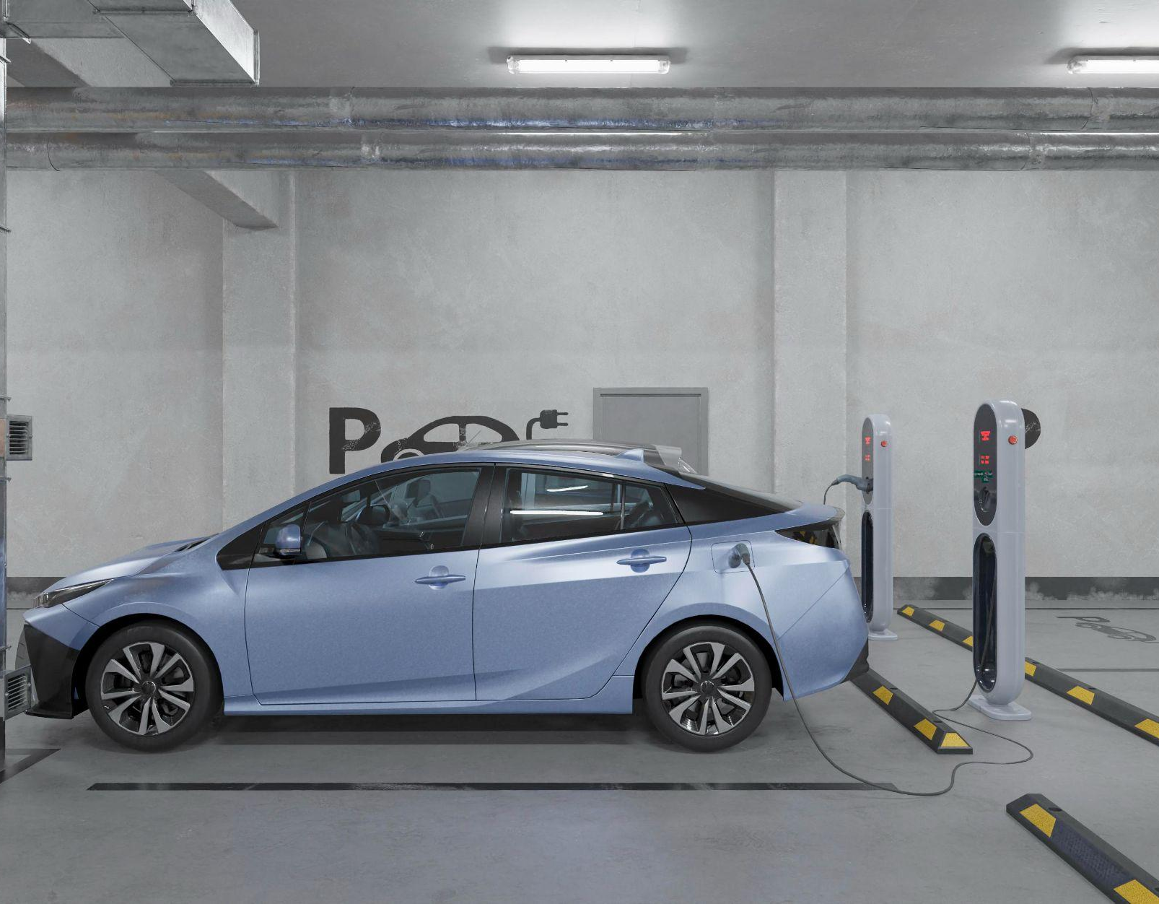
Project Scope
The project is managed through a database that will be linked to the university and car parks.
As a result of the communication between the application database and the university database, it is easy to collect information in an up-to-date manner

Slide 9
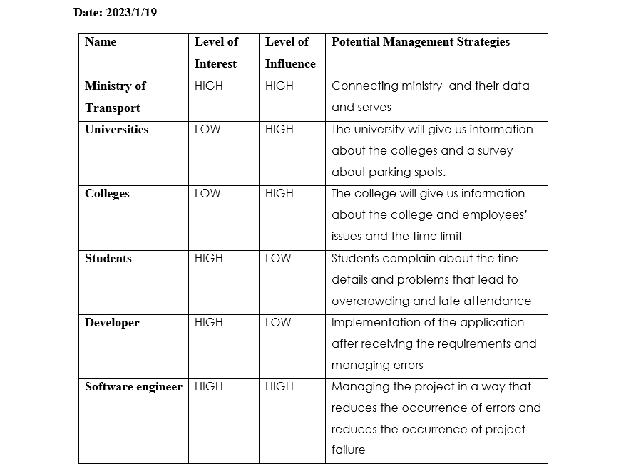
Risk Analysis

Slide 10
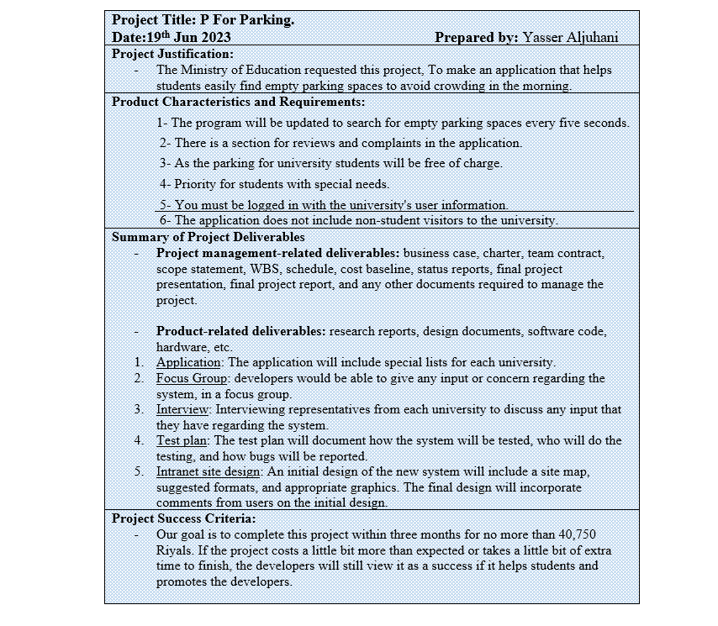
Scope Statement
Prepared by: bassam alghamdi

Slide 11
Stakeholders
Type of stakeholders | Stakeholders
client | Ministry of transport
customer | Teachers
customer | colleges
User | Students

Slide 12
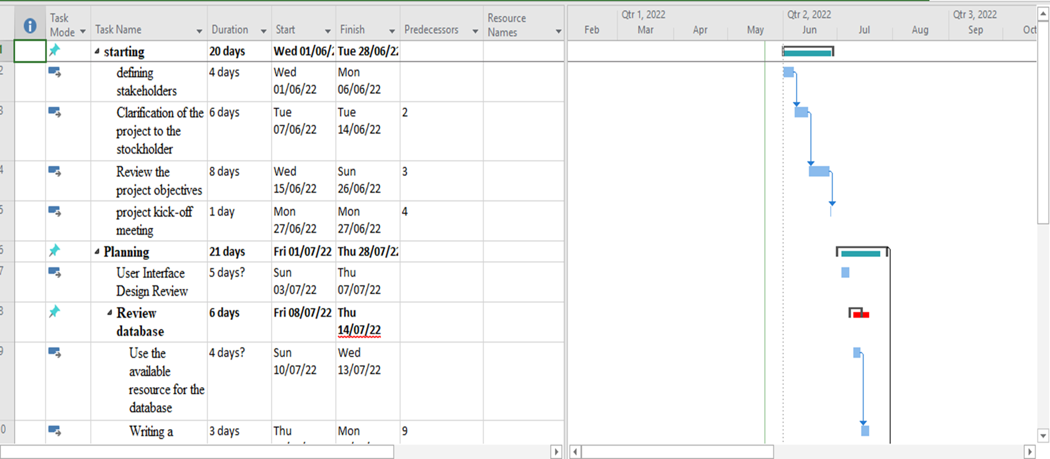
Gantt chart…..

Slide 13
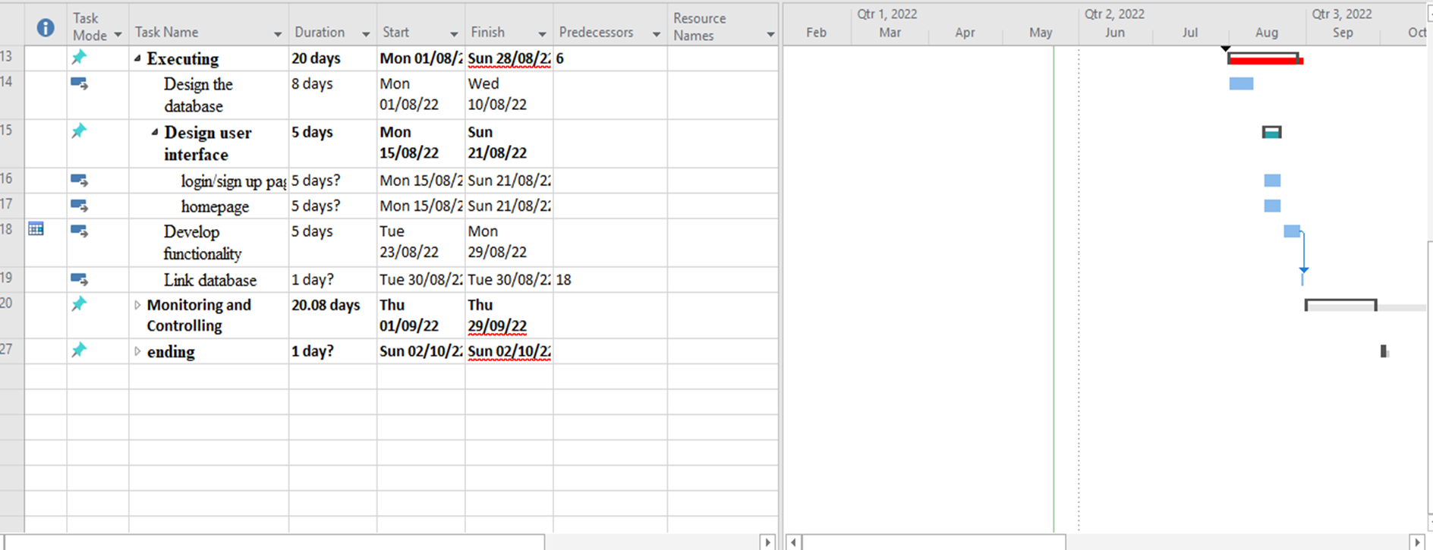
Gantt chart

Slide 14
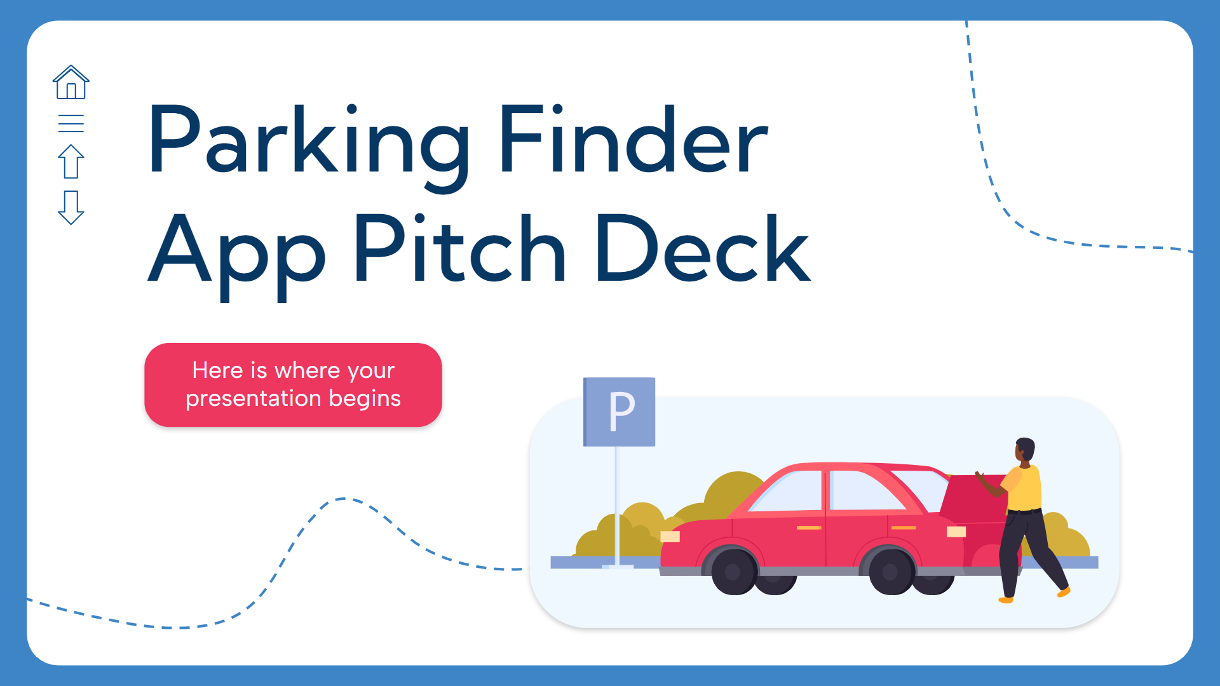
Project schedule
The project schedule takes 3 months from start to finish, divided into:
the design and creation of the database.
then the user interface design.
the user interface is developed.
The application is tested
then the application is linked to universities.
project is closed

Slide 15
Project Cost !!!
According to the initial project schedule, the project will be completed within 3 months, so the initial estimate of the costs of the entire project is 48,500 thousand riyal , divided by project management at 25 riyal per hour, application workers at 20 riyal per hour, designers at 25 riyal per hour and the equipment needed to develop the project Which will cost 15,000 riyal.

Slide 16
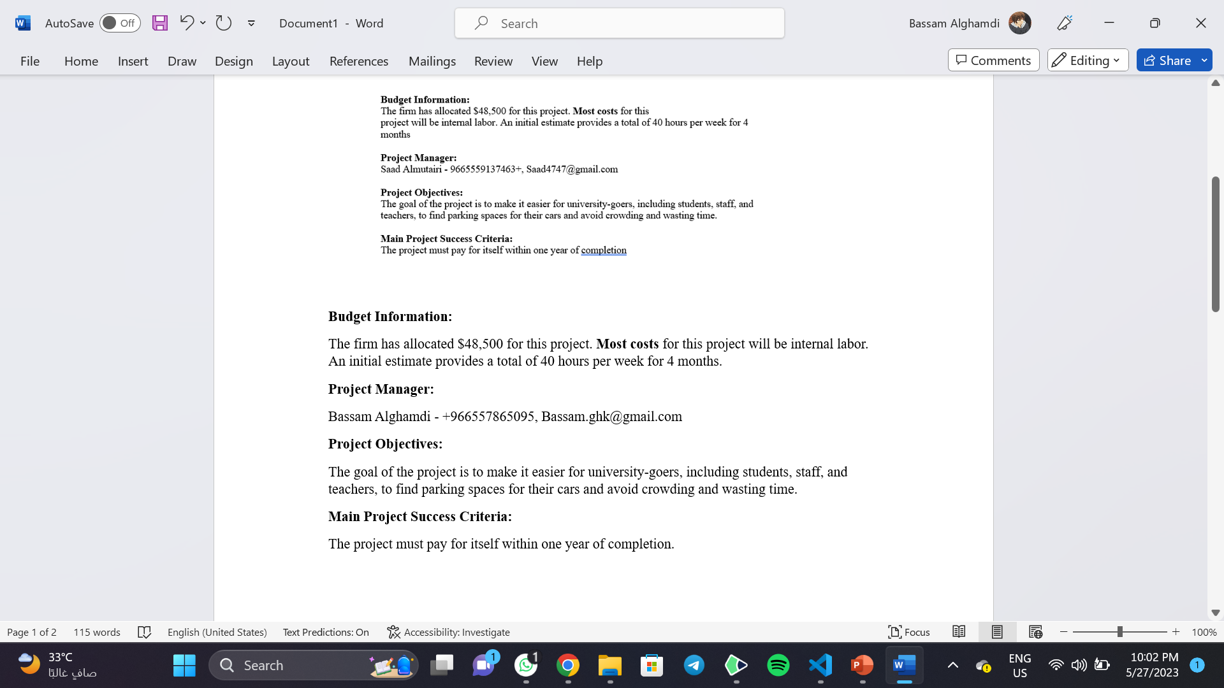
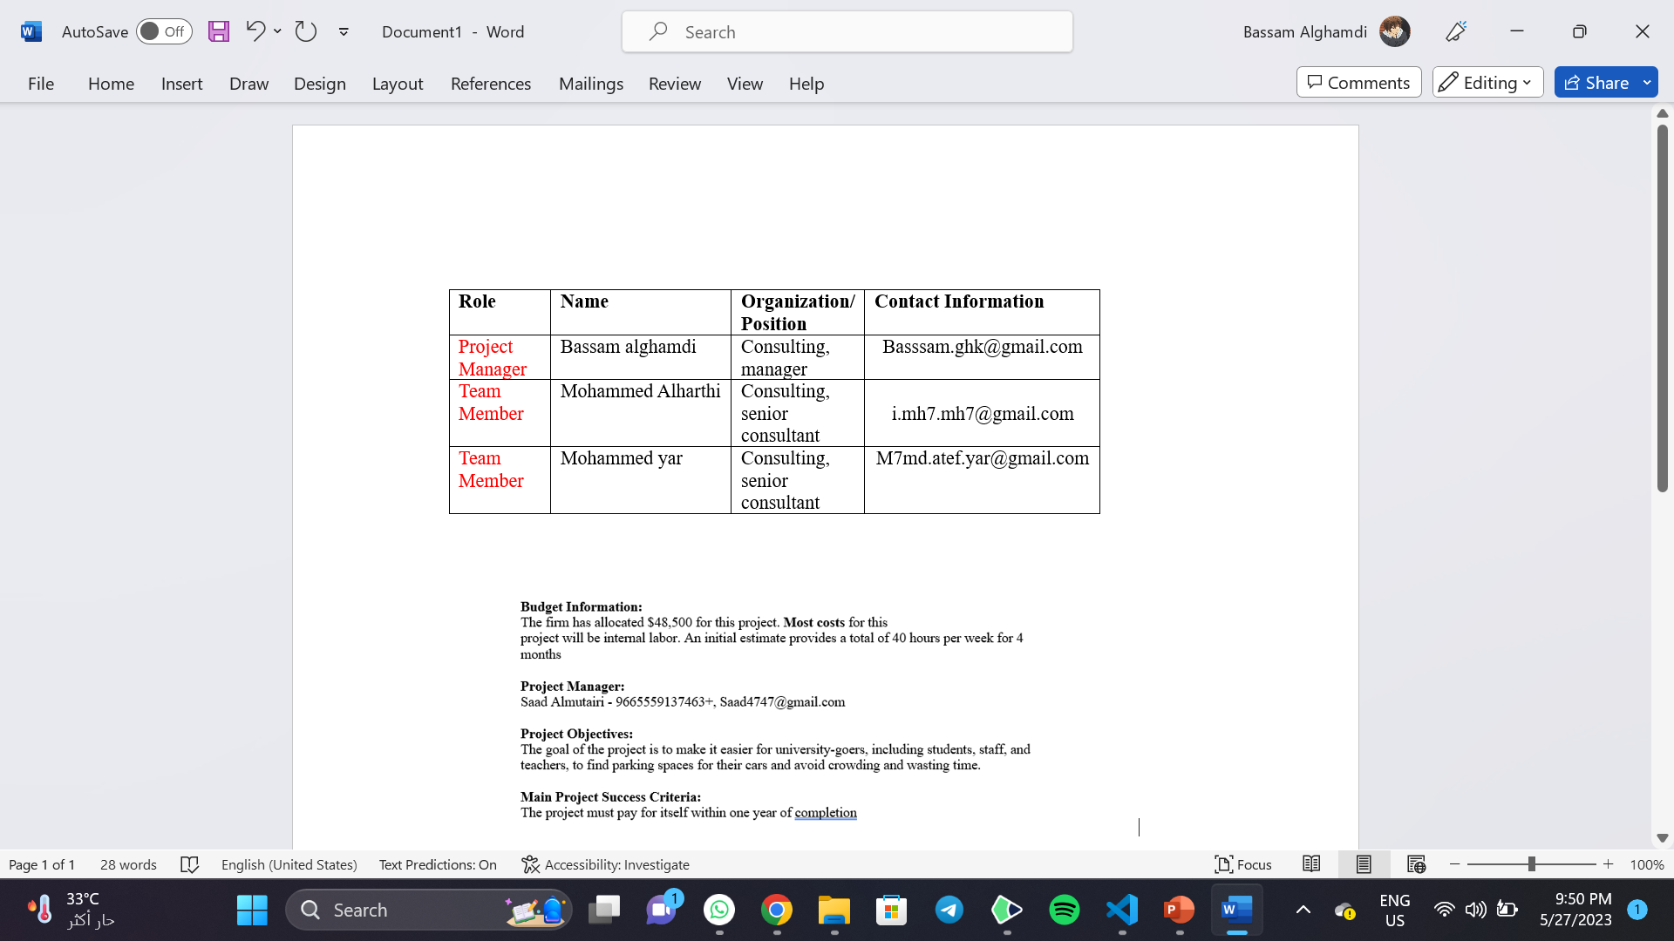
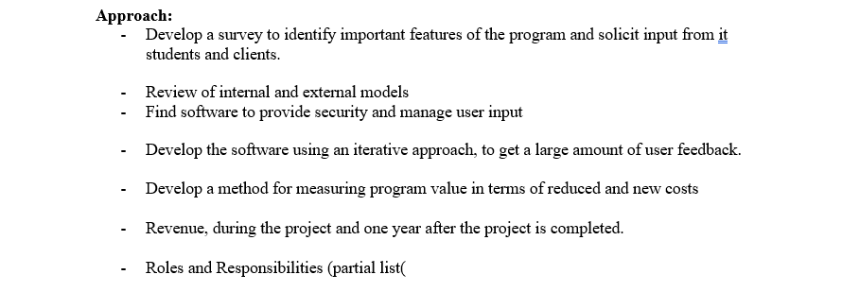
Project Charter

Slide 17
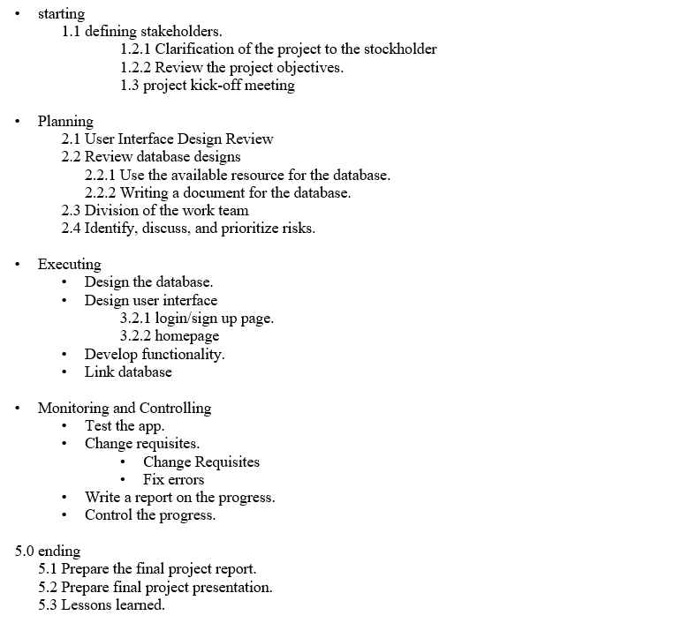
Work Breakdown Structure

Slide 18
TeamWork
Stakeholders
Report
Kick-off
PowerPoint
Bassam
Alghamdi
Mohammed
Alharthi
Mohammed
yar
Basssm Alghamdi

Slide 19
Lessons Learned
The challenges that we faced during project planning increased the sense of management in anticipating the budget for the project before starting it, and increased thinking in depth for the project

Slide 20
Report:
Introduction:
Provide an overview of the project and its objectives.
Explain the problem of parking scarcity at universities and the need for a smart parking solution.
Project Scope and Stakeholders:
Describe the scope of the project and its boundaries.
List the stakeholders involved in the project and their roles.
Use Case Diagram:
Present the use case diagram that illustrates the interactions between the users and the smart parking system.
Functional Requirements:
List the functional requirements of the smart parking system, as mentioned earlier.
Business Objectives and Benefits:
Explain the business objectives of the project.
Discuss the benefits of implementing the smart parking system for students, staff, and the university.

Slide 21
Project Schedule:
Present the Gantt chart or project schedule that outlines the project timeline and key milestones.
Risk Analysis:
Identify potential risks and challenges that may arise during the project.
Discuss strategies to mitigate and manage these risks.
Project Cost:
Provide an overview of the project cost estimate, as mentioned earlier.
Explain the breakdown of costs, including project management, application workers, designers, and equipment.
Project Charter and Work Breakdown Structure:
Summarize the project charter and work breakdown structure.
Explain how these documents contributed to project planning and organization.
Lessons Learned:
Reflect on the challenges faced during the project planning phase.
Share insights and lessons learned from the experience.
Conclusion:
Discuss the potential long-term impact of the smart parking system.
Express any future recommendations or areas for further improvement.

Slide 22

Thanks!
Do you have any questions?
Group members :
1- Bassam Alghamdi 2141362
2- Mohammed Alharthi 2141944
3- Mohammed yar 21412893

